Slide 1
Python Project for Data Science
17/04/2024

Slide 2
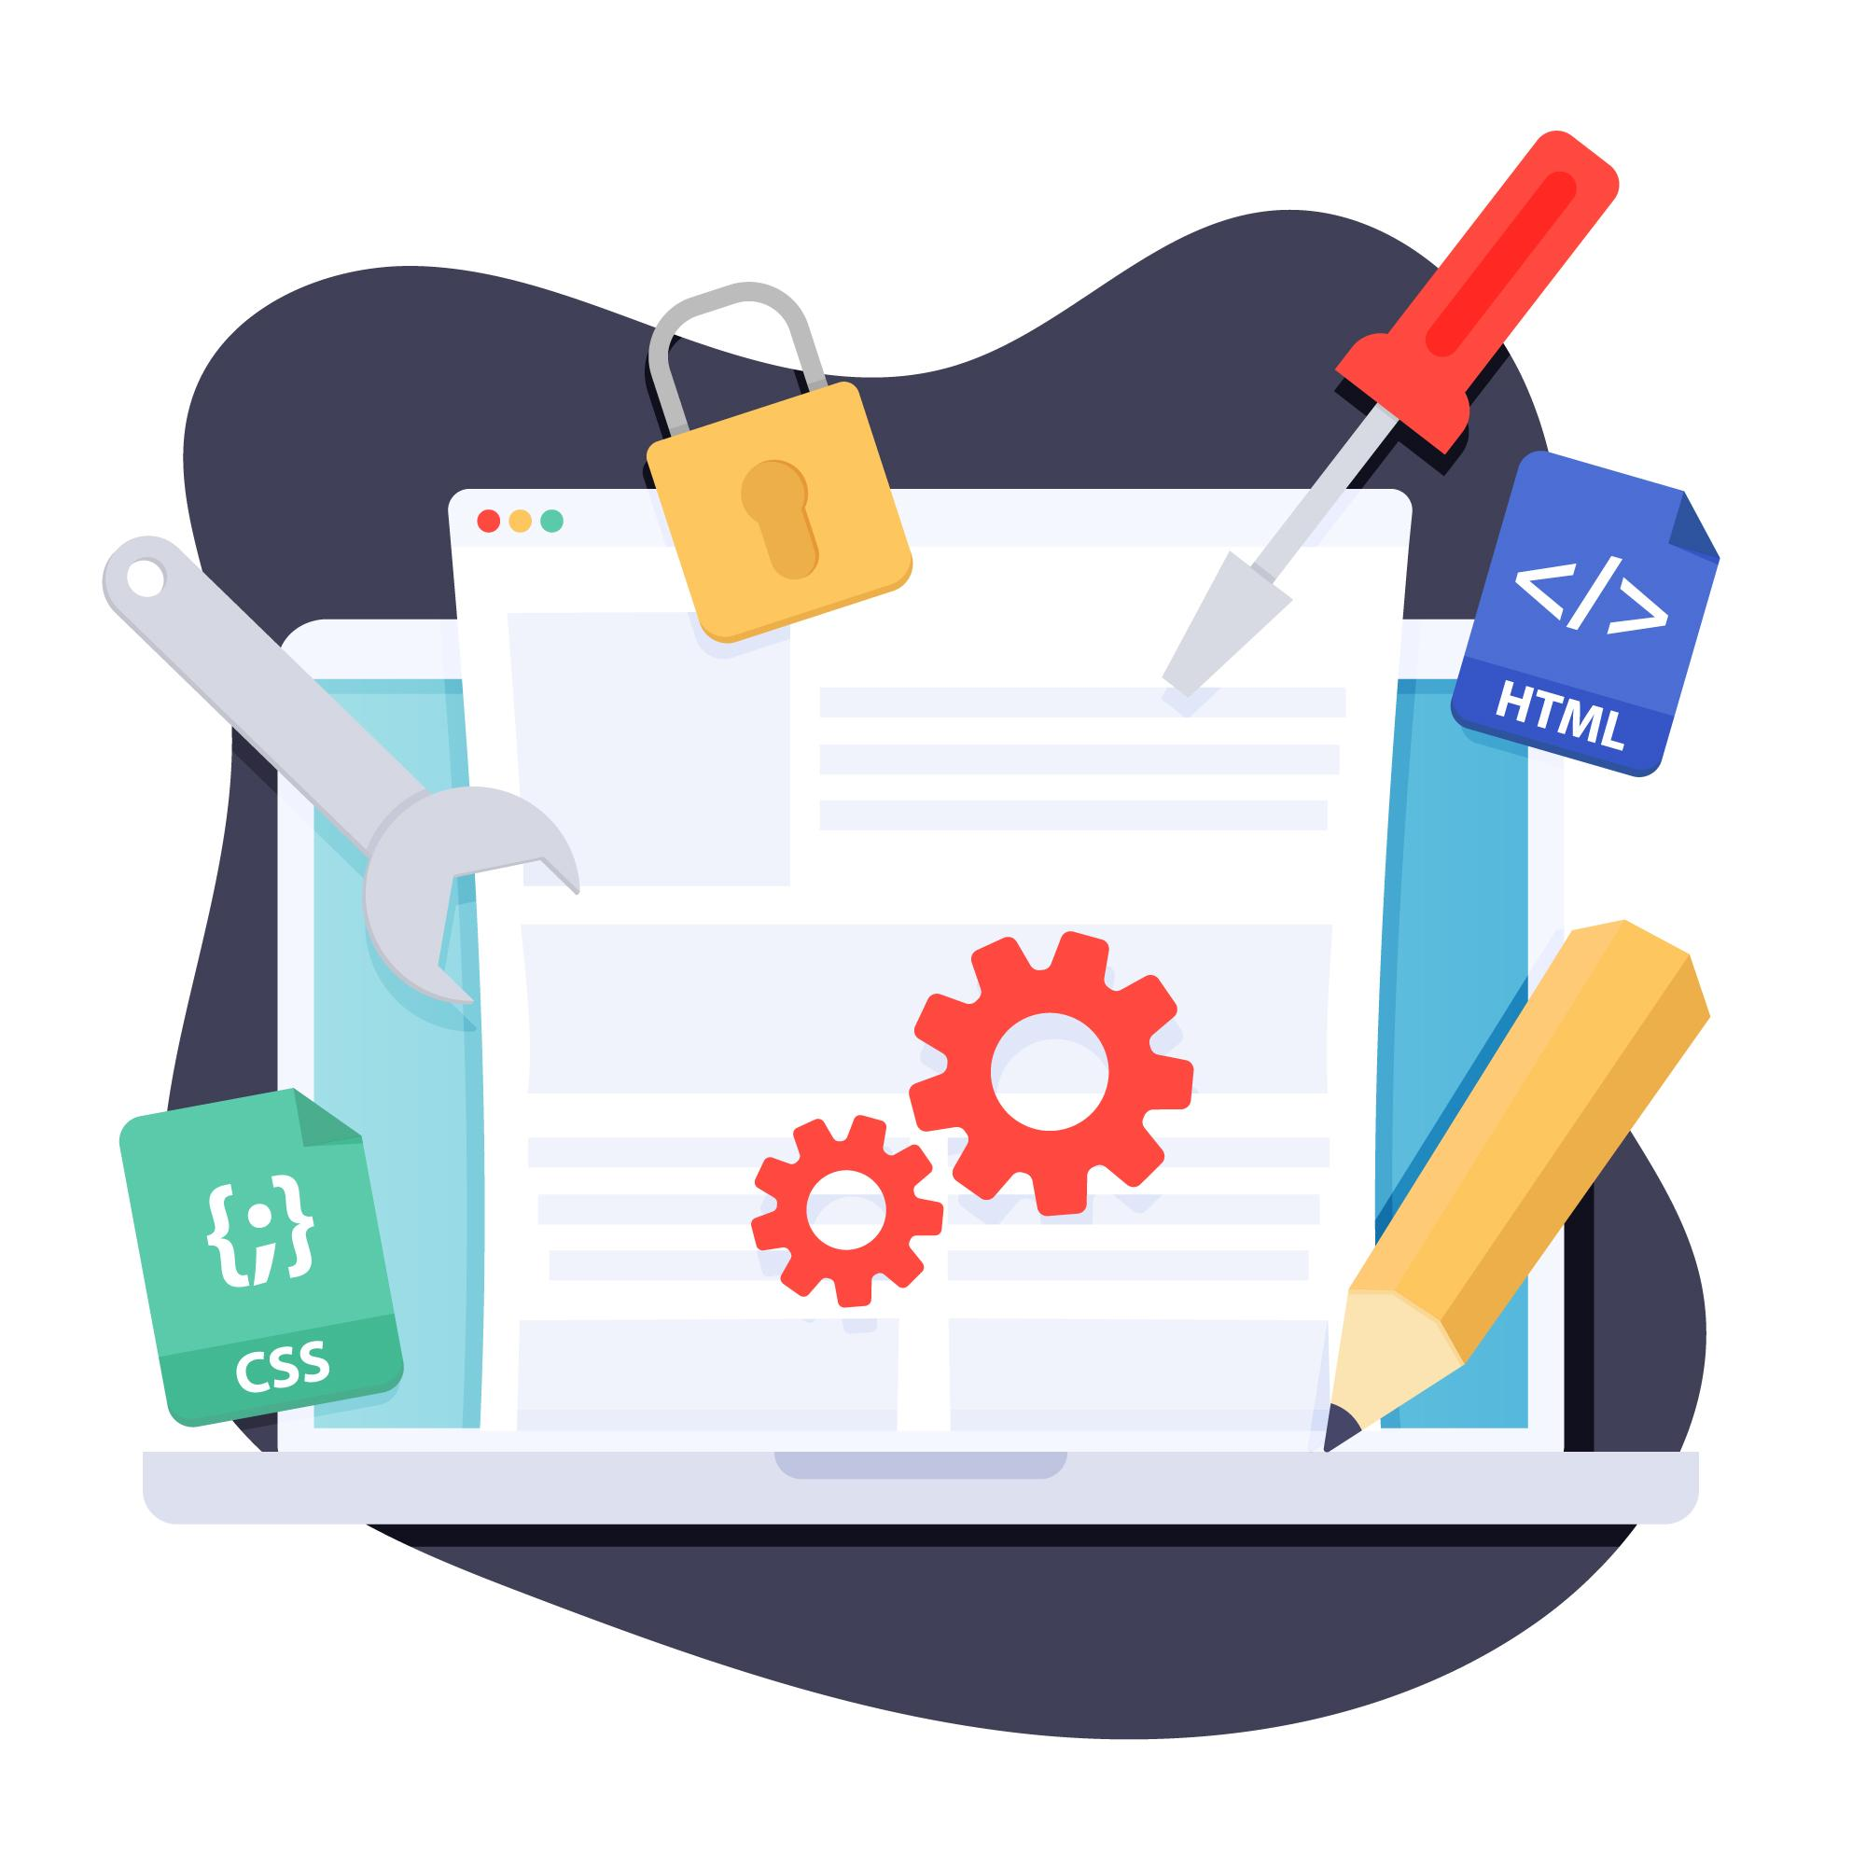
Web Scraping

Slide 3
Course Overview
You will perform specific data science and data analytics tasks such as extracting data, web scraping, visualizing data and creating a dashboard. This project will showcase your proficiency with Python and using libraries such as Pandas and Beautiful Soup within a Jupyter Notebook. Upon completion you will have an impressive project to add to your job portfolio.

Slide 4
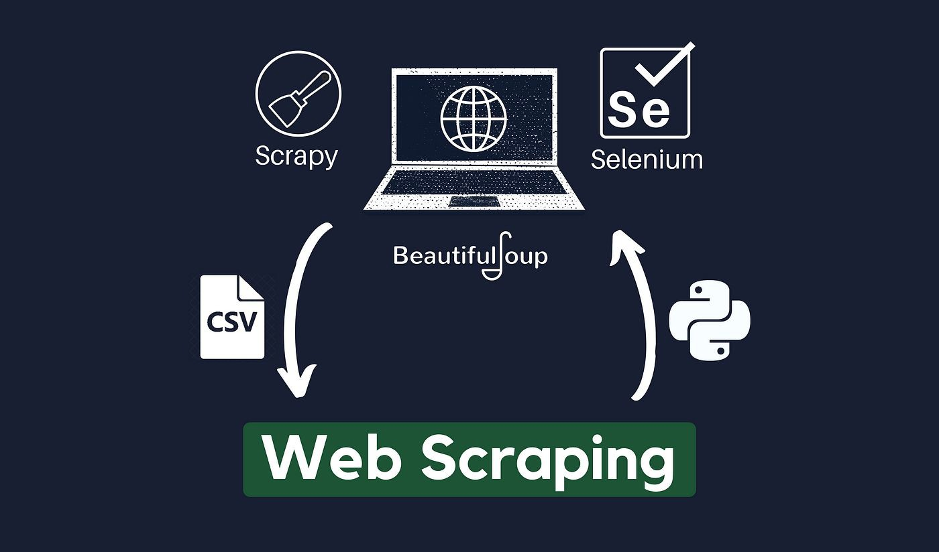
Session Content
What is Web Scraping?
How do we do?
Tools to use
Ethics for scraping
Demo

Slide 5
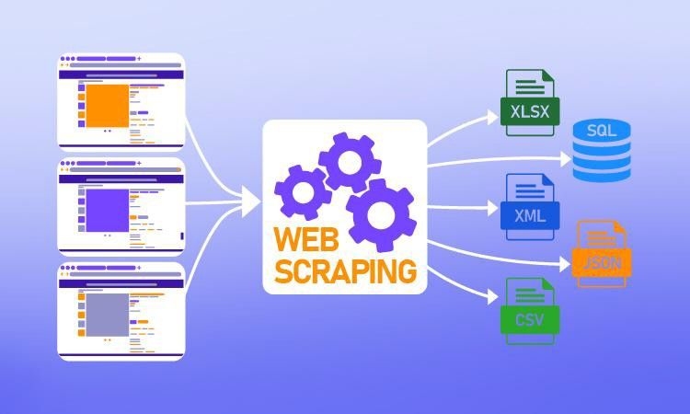
What is Web Scraping?
Web scraping: is technique for gathering data or information on web pages.
Web scraping: is method to extract data from a website that does not have an API, or we want to extract LOT of data which we can not do through an API due to rate limiting.
Through web scraping we can extract any data which we can see while browsing the web.
You could revisit your favorite website every time it updates for new information, Or you could write a web scraper to have it

Slide 6
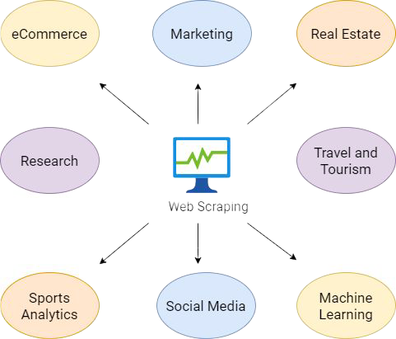
Web Scraping in Real Life
Extract products information
Extract job posting and internships
Extract offers and discount from deal of the day website
Extract date to make search engine
Gathering weather data
Etc.

Slide 7
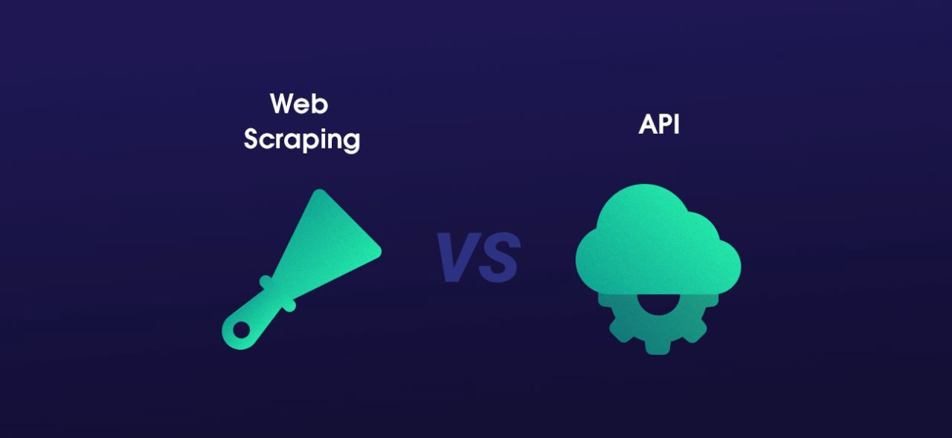
Advanced Web Scraping Vs. API
Web scraping is not rate limited
Anonymously access the website and gather data
Some website don’t have API
Some data is not accessible through an API

Slide 8
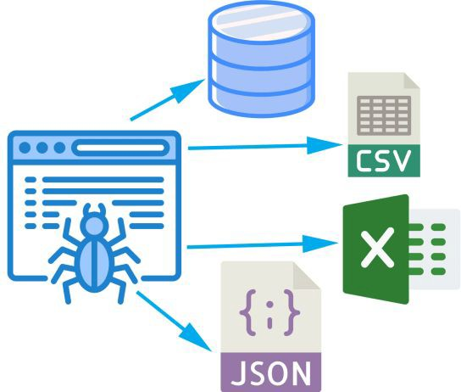
Workflow
Web scraping follows this workﬂow:
Get the website – using HTTP library
Parse the html document – using any parsing library
Store the results – either a db , csv, txt ﬁle etc.

Slide 9
Libraries
BeautifulSoup (bs4)
Lxml
Selenium
Re
scrapy

Slide 10
Is Web Scraping Legal?
In short, the action of web scraping is not illegal. However, some rules need to be followed. Web scraping is illegal when non-publicly available data is extracted.

Slide 11
Demo 1 Beautiful Soup

Slide 12
Demo 2 Selenium

Slide 13
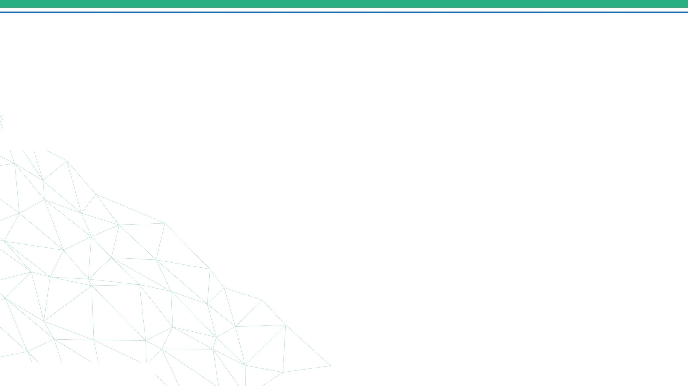


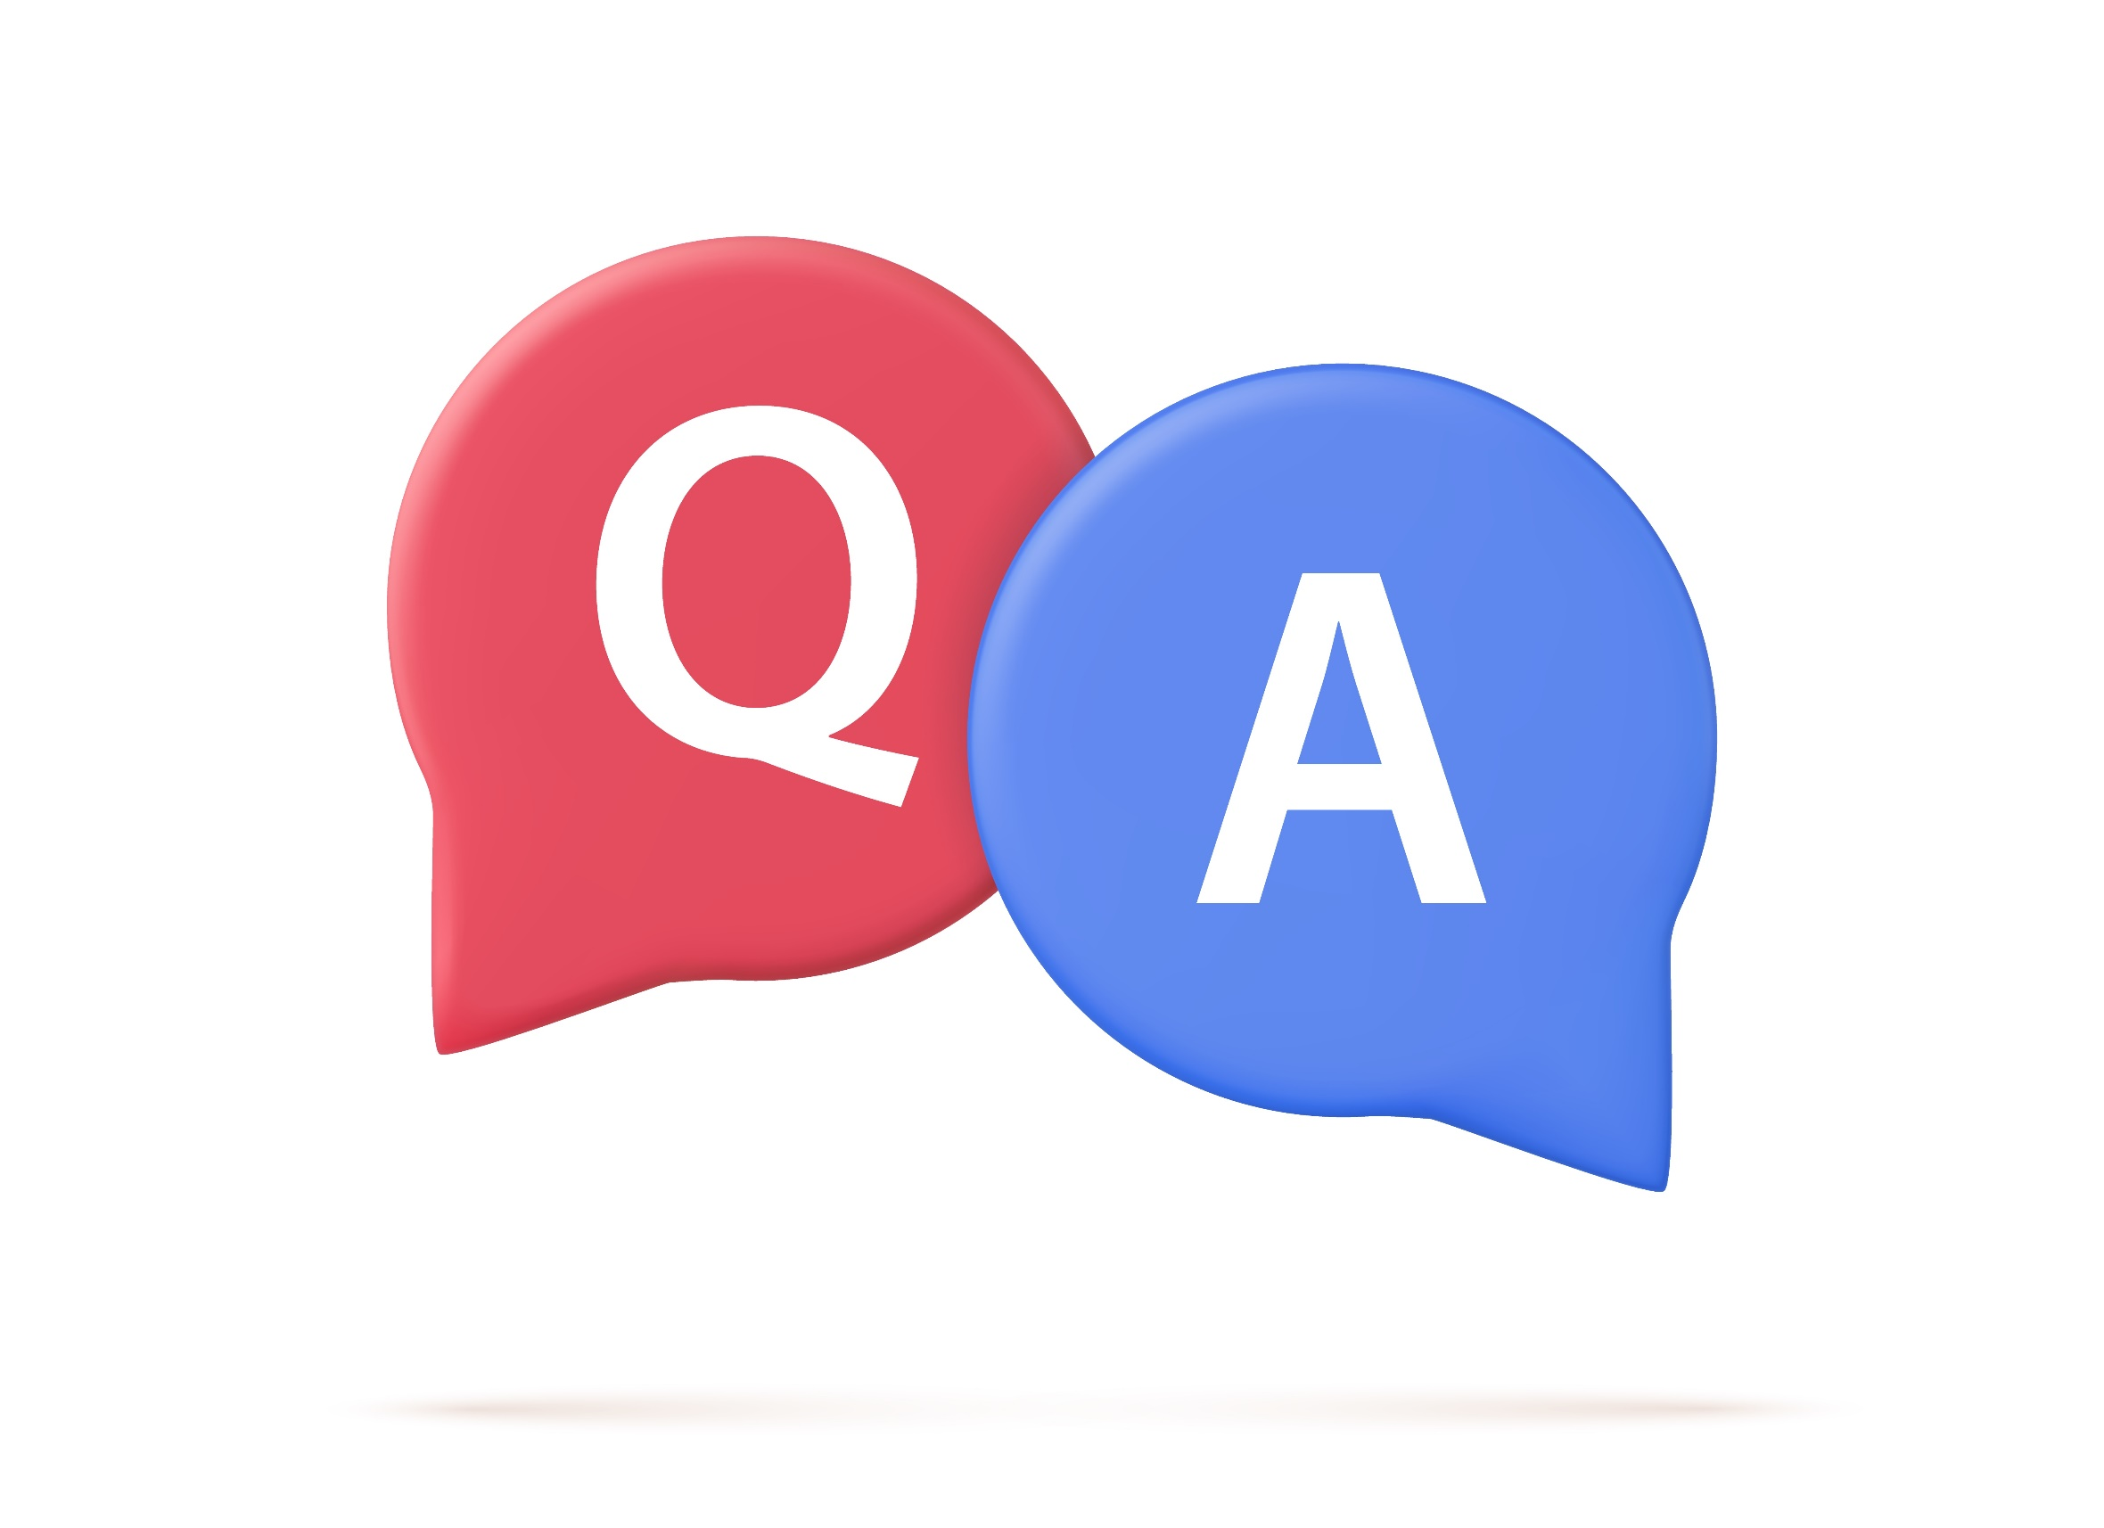
Questions & Answers
4/30/2024
34

Slide 14
Thank you!
4/30/2024
35

